Slide 1



Ficha2
De la idea a la ejecución
Notes:
3-D cyclical shapes
(Difficult)
Tip: Some shape effects on this slide are created with the Combine Shapes commands. To access this command, you must add it to the Quick Access Toolbar, located above the File tab. To customize the Quick Access Toolbar, do the following:
Click the arrow next to the Quick Access Toolbar, and then under Customize Quick Access Toolbar click More Commands.
In the PowerPoint Options dialog box, in the Choose commands from list, select All Commands.
In the list of commands, click Combine Shapes, and then click Add.
To reproduce the first shape on this slide, do the following:
On the Home tab, in the Slides group, click Layout, and then click Blank.
Also on the Home tab, in the Drawing group, click Shapes, and then under Basic Shapes click Oval (first row).
On the slide, drag to draw an oval.
Select the oval. Under Drawing Tools, on the Format tab, in the Size group, enter 4.25” into the Height box and 4.25” into the Width box.
Also on the Format tab, in the Shape Styles group, click Shape Fill, and then click No Fill.
On the Home tab, in the Drawing group, click Shapes, and then under Basic Shapes click Pie (second row).
On the slide, drag to draw a pie.
Select the pie shape. Under Drawing Tools, on the Format tab, in the Size group, enter 4” into the Height box and 4” into the Width box.
Press and hold CTRL, and select the oval and the pie. Also on the Format tab, in the Arrange group, click Align, and then do the following:
Click Align to Slide.
Click Align Center.
Click Align Middle
Select the pie shape. Drag the yellow diamond adjustment handles to create a half-circle shape, with the rounded edge facing the top of the slide.
On the Home tab, in the Drawing group, click Shapes, and then under Basic Shapes click Oval (first row)
On the slide, drag to draw an oval.
Select the second oval. Under Drawing Tools, on the Format tab, in the Size group, enter 3” into the Height box and 3” into the Width box.
Move the second oval to the center of the first oval.
Press and hold CTRL, and select the pie and the second oval. Also on the Format tab, in the Arrange group, click Align, and then do the following:
Click Align Selected Objects.
Click Align Right.
Click Align Middle.
Press and hold CTRL, select the pie, and then select the second oval. On the Quick Access Toolbar, click Combine Shapes, and then click Shape Subtract.
Also on the Home tab, in the Drawing group, click Shapes, and under Basic Shapes click Oval.
On the slide, drag to draw an oval.
Select the new oval. Under Drawing Tools, on the Format tab, in the Size group, enter 1” into the Height box and 1” into the Width box.
Select the new oval. Also on the Format tab, in the Arrange group, do the following:
Click Align to Slide.
Click Align Middle.
Click Align Center.
Press and hold CTRL, and select the new oval and the freeform shape. Also on the Format tab, in the Arrange group, do the following:
Click Align Selected Objects.
Click Align left.
Press and hold CTRL, and select the new oval and the freeform shape. On the Quick Access Toolbar, click Combine Shapes, and then click Shape Union.
To reproduce the second and third curved freeform shapes, do the following:
Press and hold CTRL, and select the freeform shape and the oval. Also on the Format tab, in the Arrange group, click Group, and the click Group.
Select the group of shapes. On the Home tab, in the Clipboard group, click the arrow to the right of Copy, and then click Duplicate.
Select the duplicate group of shapes. Under Drawing Tools, on the Format tab, in the Size group, click the Size and Position dialog box launcher. In the Format Shape dialog box, click Size in the left pane, and in the Size pane, under Size and rotate, in the Rotation box enter 120°.
Press and hold CTRL, and select both groups of shapes. Also on the Format tab, in the Arrange group, do the following:
Click Align to Slide.
Click Align Middle.
Click Align Center.
Select the first group of shapes. On the Home tab, in the Drawing group, click Arrange, and then click Ungroup.
Select the duplicate group of shapes. On the Home tab, in the Drawing group, click Arrange, and then click Ungroup.
Press and hold CTRL, select the first freeform shape, and then the duplicate freeform shape. On the Quick Access Toolbar, click Combine Shapes, and then click Shape Subtract.
Press and hold CTRL, and select the freeform shape and an oval. On the Home tab, in the Drawing group, click Arrange, and then click Group.
Select the group. On the Home tab, in the Clipboard group, click the arrow to the right of Copy, and then click Duplicate. Repeat this process until there is a total of three groups.
Select a group. Under Drawing Tools, on the Format tab, in the Size group, click the Size and Position dialog box launcher. In the Format Shape dialog box, click Size in the left pane, and in the Size pane, under Size and rotate, in the Rotation box enter 120°.
Select another group. Under Drawing Tools, on the Format tab, in the Size group, click the Size and Position dialog box launcher. In the Format Shape dialog box, click Size in the left pane, and in the Size pane, under Size and rotate, in the Rotation box enter 240°.
Press and hold CTRL, and select all three groups of shapes. Also on the Format tab, in the Arrange group, do the following:
Click Align to Slide.
Click Align Middle.
Click Align Center.
Select a group. Under Drawing Tools, on the Format tab, in the Arrange group, click Ungroup. Repeat this process for each of the groups.
Select an oval and then press DELETE to delete the oval. Repeat the process for each oval.
Select the top, left freeform shape. Under Drawing Tools, on the Format tab, in the Shape Styles group, click the Format Shape dialog box launcher. In the Format Shape dialog box, click Fill in the left pane, in the Fill pane, select Solid fill, and then click the button next to Color, under Theme Colors, click Olive Green, Accent 3, Darker 25%.
Also in the Format Shape dialog box, click 3-D Format in the left pane, and in the 3-D Format pane, do the following:
Under Bevel, click the button next to Top, and then click Slope.
Next to Top, in the Width box, enter 10 pt.
Next to Top, in the Height box, enter 5 pt.
Under Depth, click the button next to Color and then click Olive Green, Accent 3, Darker 25%.
Also under Depth, in the Depth box, enter 36 pt.
Select the bottom freeform shape. Under Drawing Tools, on the Format tab, in the Shape Styles group, click Shape Fill, point to Gradients, and then click More Gradients. In the Format Shape dialog box, click Fill in the left pane, in the Fill pane , click Gradient fill, and then do the following:
In the Type list, click Linear.
In the Angle box, enter 0°.
Under Gradient stops, click Add gradient stops or Remove gradient stops until three stops appear in the slider.
Also under Gradient stops, select Rotate with shape.
Also under Gradient stops, customize the gradient stops as follows:
Select the first stop in the slider, and then do the following:
In the Position box, enter 0%.
Click the button next to Color, click More Colors, and then in the Colors dialog box, on the Custom tab, enter values for Red: 129, Green: 84, and Blue: 25.
In the Transparency box, enter 0%.
Select the next stop in the slider, and then do the following:
In the Position box, enter 20%.
Click the button next to Color, click More Colors, and then in the Colors dialog box, on the Custom tab, enter values for Red: 204, Green: 151, and Blue: 0.
In the Transparency box, enter 0%.
Select the last stop in the slider, and then do the following:
In the Position box, enter 81%.
Click the button next to Color, click More Colors, and then in the Colors dialog box, on the Custom tab, enter values for Red: 255, Green: 236, and Blue: 93.
In the Transparency box, enter 0%.
Also in the Format Shape dialog box, click 3-D Format in the left pane, and in the 3-D Format pane, do the following:
Under Bevel, click the button next to Top, and then click Slope.
Next to Top, in the Width box, enter 10 pt.
Next to Top, in the Height box, enter 5 pt.
Under Depth, click the button next to click More Colors, and then in the Colors dialog box, on the Custom tab, enter values for Red: 129, Green: 84, and Blue: 25.
Also under Depth, in the Depth box, enter 36 pt.
Select the right freeform shape. Under Drawing Tools, on the Format tab, in the Shape Styles group, click Shape Fill, point to Gradients, and then click More Gradients. In the Format Shape dialog box, click Fill in the left pane, in the Fill pane , click Gradient fill, and then do the following:
In the Type list, click Linear.
In the Angle box, enter 0.
Under Gradient stops, click Add gradient stops or Remove gradient stops until three stops appear in the slider.
Also under Gradient stops, select Rotate with shape.
Also under Gradient stops, customize the gradient stops as follows:
Select the first stop in the slider, and then do the following:
In the Position box, enter 0%.
Click the button next to Color, click More Colors, and then in the Colors dialog box, on the Custom tab, enter values for Red: 117, Green: 21, and Blue: 21.
In the Transparency box, enter 0%.
Select the next stop in the slider, and then do the following:
In the Position box, enter 30%.
Click the button next to Color, click More Colors, and then in the Colors dialog box, on the Custom tab, enter values for Red: 194, Green: 40, and Blue: 14.
In the Transparency box, enter 0%.
Select the last stop in the slider, and then do the following:
In the Position box, enter 74%.
Click the button next to Color, click More Colors, and then in the Colors dialog box, on the Custom tab, enter values for Red: 243, Green: 72, and Blue: 3.
In the Transparency box, enter 0%.
Also in the Format Shape dialog box, click 3-D Format in the left pane, and in the 3-D Format pane, do the following:
Under Bevel, click the button next to Top, and then click Slope.
Next to Top, in the Width box, enter 10 pt.
Next to Top, in the Height box, enter 5 pt.
Under Depth, click the button next to click More Colors, and then in the Colors dialog box, on the Custom tab, enter values for Red: 117, Green: 21, and Blue: 21.
Also under Depth, in the Depth box, enter 36 pt.
Press and hold CTRL, and select all three freeform shapes. On the Home tab, in the Drawing group, click Arrange, and then click Group.
Select the group. Also on the Home tab, in the Drawing group, click the Format Shape dialog box launcher. In the Format Shape dialog box, click 3-D Rotation in the left pane, in the 3-D Rotation pane, click the button next to Presets, and then under Perspective, click Perspective Relaxed Moderately.
Also in the Format Shape dialog box, click Shadow in the left pane, and in the Shadow pane, do the following:
Click the button next to Presets, under Perspective, click Below.
In the Transparency box, enter 70%.
In the Size box, enter 90%.
In the Blur box, enter 26 pt.
In the Angle box, enter 90°.
In the Distance box, enter 0 pt.
To reproduce the background effects on this slide, do the following:
On the Design tab, in the Background group, click Background Styles, and then click Format Background. In the Format Background dialog box, click Fill in the left pane, in the Fill pane, click Gradient fill, and then do the following:
In the Type list, click Linear.
In the Angle box, enter 90°.
Under Gradient stops, click Add gradient stops or Remove gradient stops until two stops appear in the slider.
Also under Gradient stops, customize the gradient stops as follows:
Select the first stop in the slider, and then do the following:
In the Position box, enter 0%.
Click the button next to Color, and then under Theme Colors click Black, Text 1 (first row).
Select the next stop in the slider, and then do the following:
In the Position box, enter 19%.
Click the button next to Color, and then under Theme Colors click Black, Text 1, Lighter 35% (third row).
Select the final stop in the slider, and then do the following:
In the Position box, enter 62%.
Click the button next to Color, and then under Theme Colors click White, Background 1, Darker 15% (first row, first option from the left).

Slide 2
Ficha2
4 personas en 4 minutos
El concepto y su diseño
Lo reutilizado del curso
Lo evolucionado por nosotros
La demo en producción

Slide 3
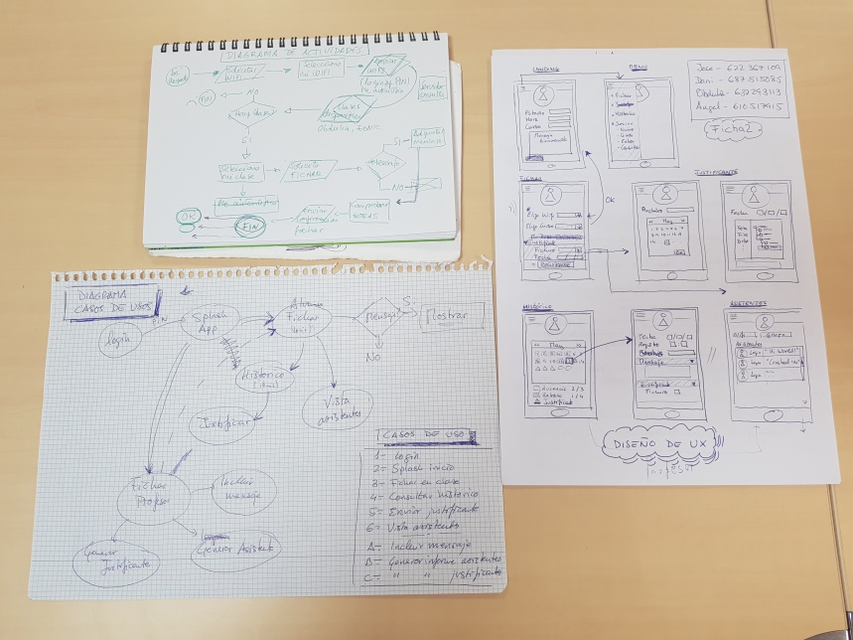
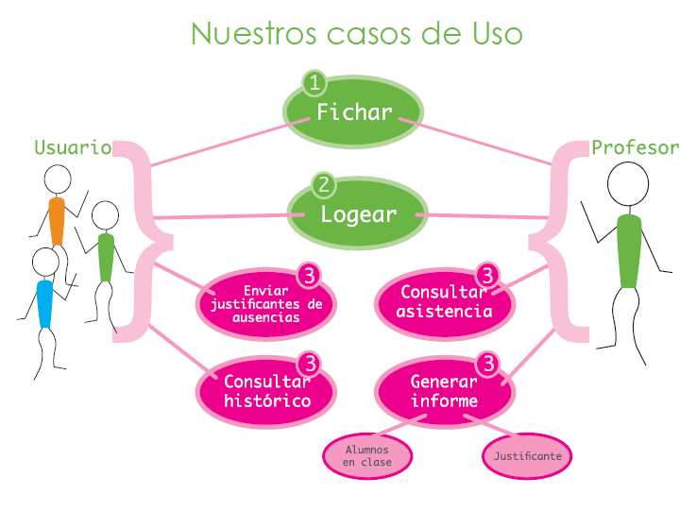
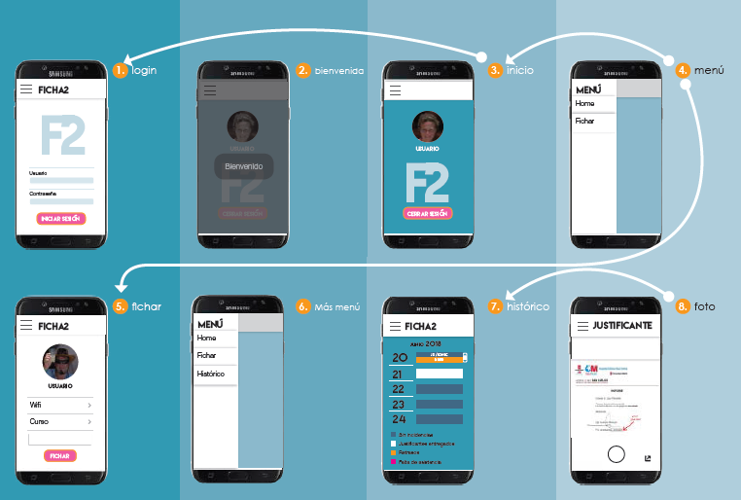
De la idea, al concepto y el diseño UX
1. Brain storming – La idea
2. Funcionalidad – Los casos de uso
3. Desarrollo – Vistas UI

Slide 4




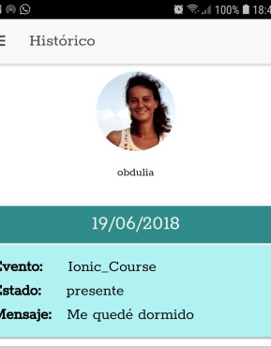
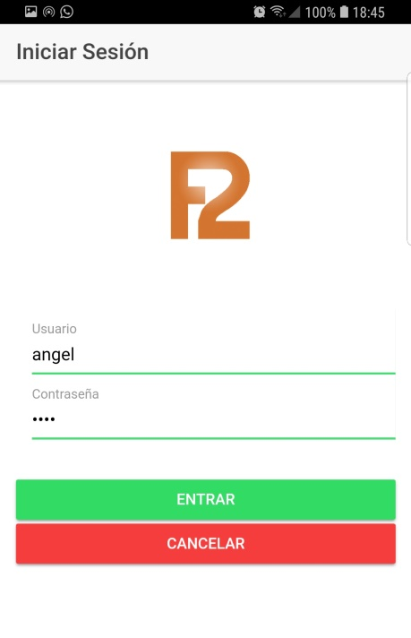
Usando lo que hemos aprendido
Ficha2
Formularios
Promesas
Dinámico
Formulario login
Autovalidación
Storage para guardar el login
HttpGET consulta login y pwd
JSON con los wifis registrados
Html cambia si estas logado o no
Uso de Bindings
ngIf, ngFor, valid

Slide 5

Algunas curiosidades de nuestro código …
App
Servidor
Datos
Plantilla
Modulo
BBDD
(json)
Componentes
Servicios App
Servidor emulado
Librerías
Servidor
Base Datos
Gestionar el Wifi
Enviar email
Servidor.service.ts
Emulado injectable
Login, consulta BD
Arquit. 3 capas
Capa en github
JSON con 3 BBDD
Lo hicimos porque nadie nos dijo que era imposible en una semana !!

Slide 6
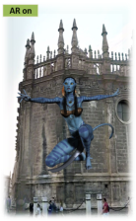

The concept: what and why
USER: Visit the city in a different way. Gamification of city guide. Play outdoors socially
VISIT
PLAY
REWARD
Tourism
Discover your city
“Stages”: tourist spots
Enjoy outdoor
Social game
Compete
Voucher, discount
Private offers
Badges and rank
SPONSOR: drive traffic to my shop. Offers publicity. Groups & city events dynamization

Slide 7

Versión beta-tester disponible
Menú principal
Configuration & options.
Describe here what to configure
Main menu and configuration.
Fichar
Enviar justificante
Resumen mensual
Perfil usuario
Darse de dalta

